Slide 1
Questions that can’t be answered with 3 chords alone
Sometimes we need to extract data (eg a postcode in an address) to pivot
Sometimes we need to combine data (eg codes > descriptions)
Sometimes we need to classify data to pivot

Slide 2
Challenge:
gender pay gap data
What is the average pay gap in Birmingham? (B postcodes)
Which industry sector (SIC code) has the biggest and narrowest pay gap?
How many companies have a pay gap favouring women?

Slide 3
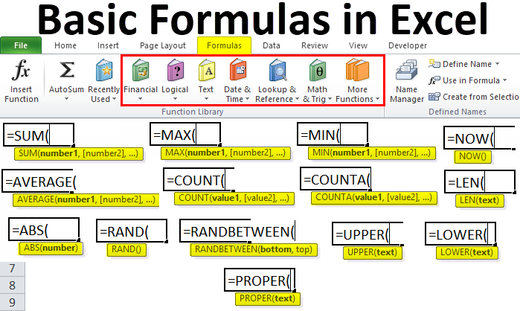

We need functions and formulae
@PaulBradshaw MED7373 Data Journalism
MA Data Journalism, Birmingham City University #bcujournos

Slide 4
We will cover…
How to use formulae to find story leads
What functions are — and why they’re useful
…and some especially useful functions for journalists

Slide 5
Using a formula
A formula asks the spreadsheet to do something, not just store data
A formula starts with one equals sign
It can use a mix of values, strings, cell references, and/or functions

Slide 6
These are all formulae:
=2+3+4
=A2+A3+A4
=SUM(A2:A4)
=A2/100
=”http://”&A2
=SUM(A2:A4)*2
=SUM(A2:A4)+SUM(B2:B4)

Slide 7
A note on ‘operators’
Action | Operator | Result
Add | + | Number
Subtract | - | Number
Divide by | / | Number
Multiply by | * | Number
Is less than | < | Boolean (TRUE/FALSE)
Is more than | > | Boolean (TRUE/FALSE)
Is equal to | = | Boolean (TRUE/FALSE)
Is not equal to | != | Boolean (TRUE/FALSE)
Join | & | String (combined)

Slide 8
Try it now
Dividing a part by the whole to get a %
=10/50
Checking if a cell’s value is greater than a key measure (e.g. a target or average)
=A2>0.8

Slide 9
A function is a special word in Excel or Google Sheets
E.g. SUM, AVERAGE, COUNT, etc.
Non-special words (normal text) in a formula should be placed “inside quotation marks”, e.g. =LEN(“hello”)
If you forget the quotes (or misspell a function) you’ll get a #NAME? error

Slide 10
Google ‘Excel function for…’
Calculations (sum, count, average, max, ranges, rank)
Text (length, extraction, splitting, replacing, finding, combining, translate)
Date/time (year, month, day, format)
Currency (conversion, format)
Statistics (STDEV, CORREL, QUARTILE)

Slide 11
Try it now
Find a function for calculating an average
Find a function for measuring the length of text
Find a function for extracting the month from a date

Slide 12
‘Excel function for…’
True/False tests (data type, >, <, =, !=)
Instructions (If/else)
Categorising (rank)
Fetching info (time, currency rate, matching data, INDEX, IMPORTHTML)
Combinations of the above! (count + if, if + sum)

Slide 13
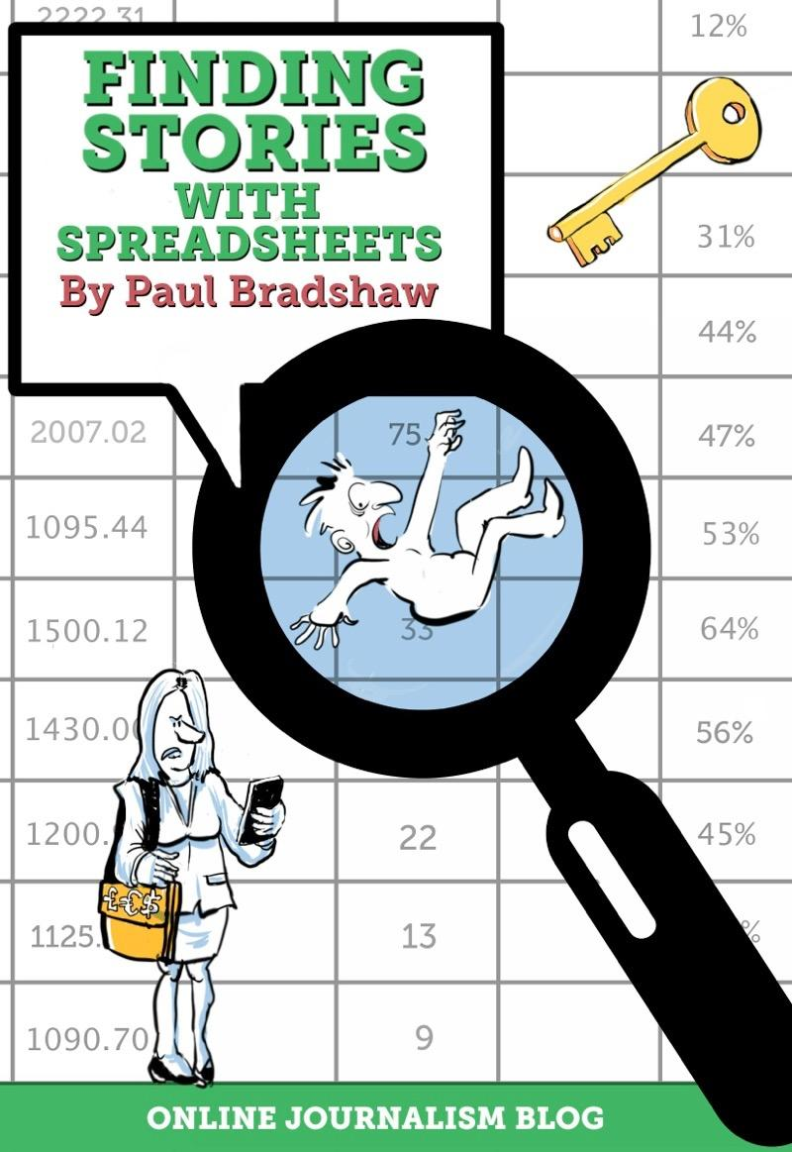
Recipe book.
https://leanpub.com/spreadsheetstories/c/bcustudents

Slide 14
Open up your data
gender-pay-gap.service.gov.uk/ viewing/download

Slide 15
A function is always followed by parentheses (ingredients)
They can be empty, e.g. TODAY()
Ingredients: “arguments/parameters”
If more than 1, separated by commas/semi colons
Some are optional

Slide 16
Using functions - and arguments
= only once at the start
SUM is a function to be applied
( contains the arguments for that formula
D2:D300 this is a range (array) of cells*
) ends the list of arguments

Slide 17
Calculate an average
Open Gender Pay Gap data
Copy columns A-G into a new sheet
Leave columns empty before analysis
Create a calculations column. Try:
=AVERAGE(G2:G10830)

Slide 18
EmployerName | EmployerId | Address | PostCode | CompanyNumber | SicCodes | DiffMeanHourlyPercent | ​​ |  | CALCULATIONS
'PRIFYSGOL ABERYSTWYTH' AND 'ABERYSTWYTH UNIVERSITY' | 19070 | Aberystwyth University, Penglais, Ceredigion, SY23 3FL | SY23 3FL | RC000641 |  | 9.7 |  |  | 13.12
"RED BAND" CHEMICAL COMPANY, LIMITED | 16879 | 19 Smith's Place, Leith Walk, Edinburgh, EH6 8NU | EH6 8NU | SC016876 | 47730 | 2.45
10X BANKING TECHNOLOGY UK LIMITED | 22185 | Suite A, 5th Floor, 33 Holborn, London, Greater London, United Kingdom, EC1N 2HT | EC1N 2HT | 11738306 | 62090 | 19
1509 GROUP | 15320 | Royal Grammar School, High Street, Guildford, Surrey, GU1 3BB | GU1 3BB | 4104101 | 85200, 85310 | 16.13

Slide 19
Use column ranges (quicker)
=SUM(D:D) ignores any text/empty cells
=SUMIF(D:D, “<10000”)
=SUMIFS(D:D,E:E,"=A*",F:F,"Tom")
=MAX(D:D)
=MIN(D:D)

Slide 20
Sense-checking: mean vs median average (skewed?)
=AVERAGE(G:G)
=MEDIAN(G:G)
=MODE(G:G) - for ‘most common’: useful for ordinal ratings which shouldn’t be averaged.

Slide 21
COUNT functions:
Checking data completeness
=COUNT(G:G)
=COUNTA(G:G)
=COUNTBLANK(G2:G10800)
=COUNTIF(G:G, “>0”)
=COUNTIFS(D:D, “Individual”, B:B,”<10000”)

Slide 22
More than 100 BBC executives on six-figure salaries despite director-general's pledge to curb top-level pay
More than 100 of the BBC's top earners make at least £100,000 a year
Some 13 executives at the corporation given pay rises of up to 10%
Director-general Tony Hall is trying to cut the numbers of executives
More than 100 BBC executives are earning six-figure salaries, despite pledges to curb top pay and offer viewers better value for money,
New figures have revealed that more than 100 of the corporation's top earners make at least £100,000 a year, and 80 of them are on salaries of £150,000 or more.
According to an official BBC register of elite staff, 13 executives were also given a pay rise of up to 10 per cent, at a time when the broadcaster is facing cuts to its spending.
This story demonstrates how you might use COUNTIF (count how many cells are >100000)

Slide 23
Count empty cells
The COUNTBLANK function counts how many cells are blank
=COUNTBLANK(F2:F10830)

Slide 24
Stories you can report quickly
The average company has a pay gap of ____%
____ companies in official data don’t give an SIC code

Slide 25
Create new columns to classify our data
Create a formula based on the first cell and copy that down, e.g.
=ISBLANK(F2)

Slide 26
THE
BLACK CROSS DOUBLE
CLICK

Slide 27


Slide 28
COUNTIF, SEARCH, FIND
Check if text contains keyword
Use wildcards:
=COUNTIF(D2, “*coffee*”) 1 or 0
=SEARCH(D2, “coffee”) - position
=FIND(D2, “Coffee”) - case sensitive

Slide 29
LEN, RIGHT, LEFT, MID
Measure length of text,
Grab characters from specified positions

Slide 30
Create new columns to extract data
Create a formula based on the first cell and copy that down, e.g. extract the first part of an industry code like 47730
=LEFT(F2,2)

Slide 31
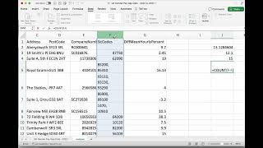
This video covers what we’ve covered in this lecture https://www.youtube.com/watch?v=OZ9zZJUjVKI

Slide 32
Create new columns to match and fetch data
‘Lookup’ functions look up data that you want to combine with your own
=XLOOKUP(F2,lookupdata!A:A, lookupdata!B:B)

Slide 33
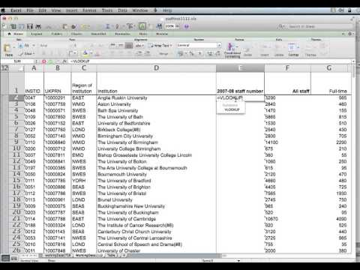
The VLOOKUP function will fetch data in a very similar way. The video embedded above walks through how to use that: https://youtu.be/tR_Yhz3kl7M

Slide 34
Can you find out:
How many companies have a gender pay gap favouring men?
What proportion of companies have an SIC code beginning 47 (retail sales)?

Slide 35
Summary:
Don’t worry about memorising functions - just remember what they can do
Especially XLOOKUP (few know how to use it without checking)
If you have a problem, search for a function that does what you need

Slide 36
Directed study:
Identify a dataset
Generate story ideas using the 7 angles
Pick one that requires you to extract or combine data
Break the challenge down into problems
Identify what you need to do - find functions that can do it (try genAI)
Write the story!
+ Add quotes (interviews)

Slide 37
Reading.
(Ch4-7 + 12)
https://leanpub.com/spreadsheetstories/c/bcustudents

